Slide 1

Solar Energy Production Forecast
Three-hourly forecast Île-de-France
Team Solar Power (Yijun ZHU, Raphaël ADAMCZYK, Hani CHERID)

Slide 2
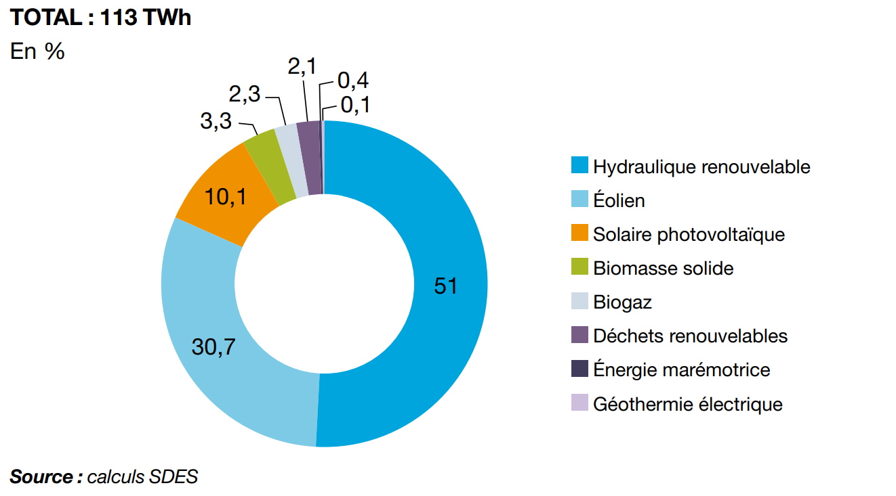
Overview
Steadily growing for several years, renewable energy now represents more than 21% of total electricity production in 2019 in France (RTE).
As an important part of renewable energy, solar PV represents 10.1% of gross renewable electricity generation.
Gross renewable electricity production by Sector in 2019

Slide 3
Project framework
Project definition
Data mining and processing
Data exploration
Data modeling
Evaluation and prediction
1
2
3
4
5

Slide 4
Challenges
With the advantage of being cleaner than traditional energy sources like coal or oil, renewable energies come with multiples challenges:
Electricity produced from renewable sources is very difficult to store. Batteries and other storage capacities are not mature enough technologically speaking. The power is handled smartly over “grids” that would redirect supply where the demand lies on the network.
Overproduction results in loss of money.
Renewable energies like solar and wind energy are directly dependent on the weather which is dynamic and complex to forecast.
Shortage of power due to lack of sun radiation results in inconvenience for clients, a fine from the government and impact on provider reputation.
This calls for an accurate forecast and management of energy production based on external conditions.

Slide 5
Project Objectives
Apply different models (Time Series, Machine Learning & Deep Learning) to 2017-2020 Solar Energy Production Data combined with Weather and Solar radiance Data in Île-de-France region and choose the best one in order to forecast production of solar energy with a lead time of 1 day to 1 week.

Slide 6
Project framework
Project definition
Data mining and processing
Data exploration
Data modeling
Evaluation and prediction
1
2
3
4
5

Slide 7
Data Collection
Datasets | Time step | Time range | Location / region | Key features
Solar Energy Production | Half-hourly | 2017-01-01 to 2020-12-31 | Île-de-France | Solaire (MW)
Solar Radiance | Three-hourly |  | Île-de-France | Rayonnement solaire global (W/m²) Vitesse du vent à 100m (m/s)
Weather | Hourly |  | Station Paris Montsouris | Air temperature (10*°C) Precipitation per hour (10*mm) Station pressure rate (10*hPa) ...
Source: Commission de régulation de l'énergie (CRE) Open Data, National Centers for Environmental Information

Slide 8
Preprocessing of datasets
The datasets coming from different sources, their format needed to be cleaned and standardized:
Selection of observed information related to the region Ile de France
Data type assignment (date, integer,...)
Substitution of missing values
Removal of useless or redundant information based on correlation analysis
Concatenation of all datasets into one with a three-hourly frequency

Slide 9
Concatenated dataset shape
Response variable : Solar power production (MW)
Covariates :
Temperature of the air (°C)
Hourly precipitation depth (mm)
Air pressure surrounding weather station (Pa)
Wind speed at 100m altitude (m/s)
Global Solar radiation (W/m2)
Time frame : 1st January 2017 01:00AM to 31st December 2020 10:00PM

Slide 10
Project framework
Project definition
Data mining and processing
Data exploration
Data modeling
Evaluation and prediction
1
2
3
4
5

Slide 11

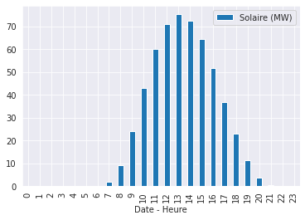
Data exploration
Key observations
Daily seasonality
The production of solar energy reaches the peak at 13h
Negligible from 22:00 to 06:00 corresponding to night time

Slide 12
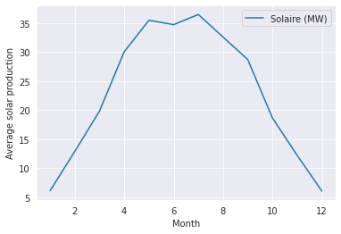
Data exploration
Monthly seasonality
The production of solar energy in Ile-de-France region is:
the highest from May to July (spring to summer season)
the lowest from November to February (winter season)

Slide 13
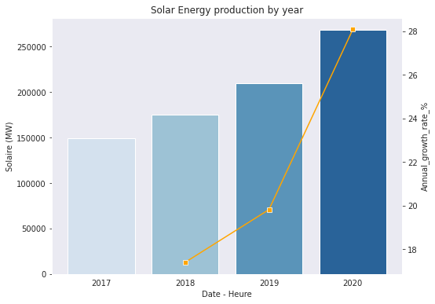
Data exploration
Yearly evolution
28%
From 2017 to 2020, the production of solar energy grows at an increasing rate
20%
17%

Slide 14
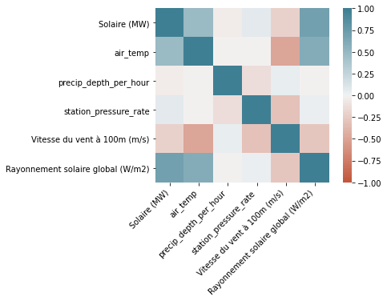
Data exploration
Pearson correlation between initial features
From the graph we observe a clear and strong correlation between solar radiation and the production of solar energy. A weaker correlation with air temperature can be identified.
There is no strong correlation between the features other than solar energy observed.

Slide 15
Project framework
Project definition
Data mining and processing
Data exploration
Data modeling
Evaluation and prediction
1
2
3
4
5

Slide 16
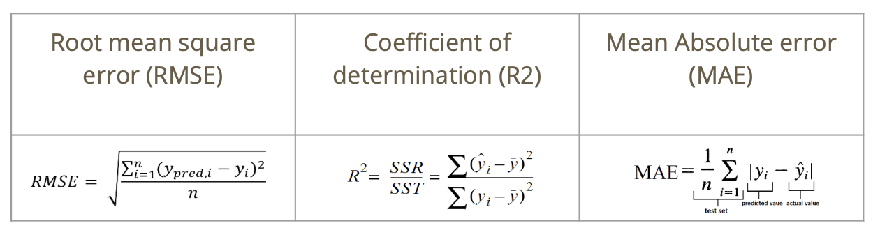
Data modeling
Multiple models were considered for the project using:
Time series analysis
Machine Learning techniques
Deep Learning techniques
The metrics used to compare those models were :

Slide 17
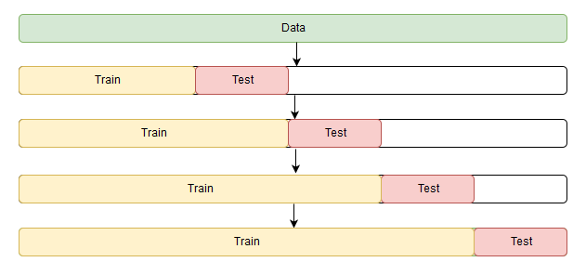
Data modeling - Time series cross validation
Cross-validation for time series is a bit different because time series have a temporal structure and one cannot randomly mix values in a fold while preserving this structure.
So we used a method of "cross-validation on a rolling basis" which can be established using the sklearn.model_selection's TimeSeries Split module.
Source: mlcourse.ai
Notes:
The idea is rather simple -- we train our model on a small segment of the time series from the beginning until some , make predictions for the next steps, and calculate an error. Then, we expand our training sample to value, make predictions from until , and continue moving our test segment of the time series until we hit the last available observation. As a result, we have as many folds as will fit between the initial training sample and the last observation.

Slide 18
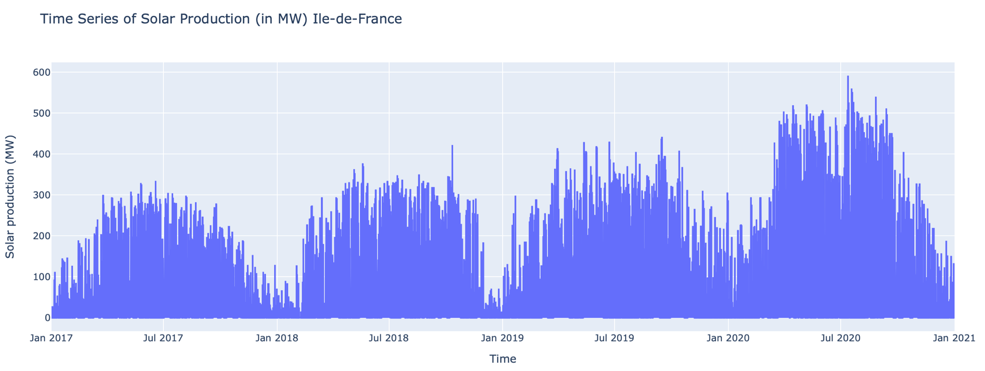
Data modeling - Time series analysis
Main difficulty : Handling multiple seasonalities and trend pattern

Slide 19
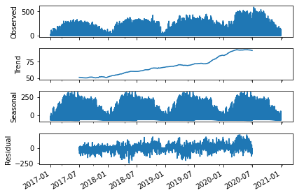
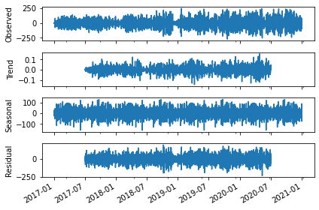
Data modeling - Time series analysis
Prior to consider a model, the series stationarity have to be evaluated. We start by decomposing the series and remove trend pattern by differentiation.

Slide 20
Data modeling - Time series analysis
Method used to evaluate the stationarity of the series : Dicky Fuller test and KPSS
DF test outcome on original series => seems stationary (p-value 2.75 * 10^(-5))
KPSS test outcome on original series => not stationary (p-value 0.01)
DF test outcome on differentiated series => seems stationary
KPSS test outcome on differentiated series => seems stationary
Conclusion: 1st order differentiated series will be used to fit the model

Slide 21
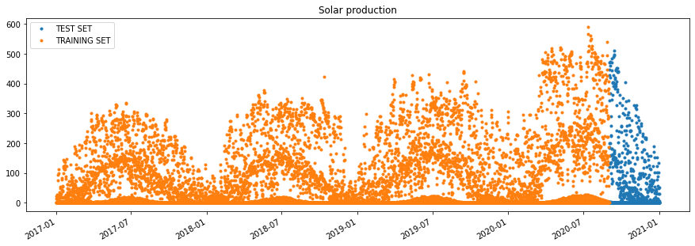
Data modeling - Time series analysis
The 1st model considered to deal with multiple seasonality : FBProphet
Developed by Facebook
Based on an additive model where non-linear trends are fit with yearly, weekly, and daily seasonality, plus holiday effects.

Slide 22
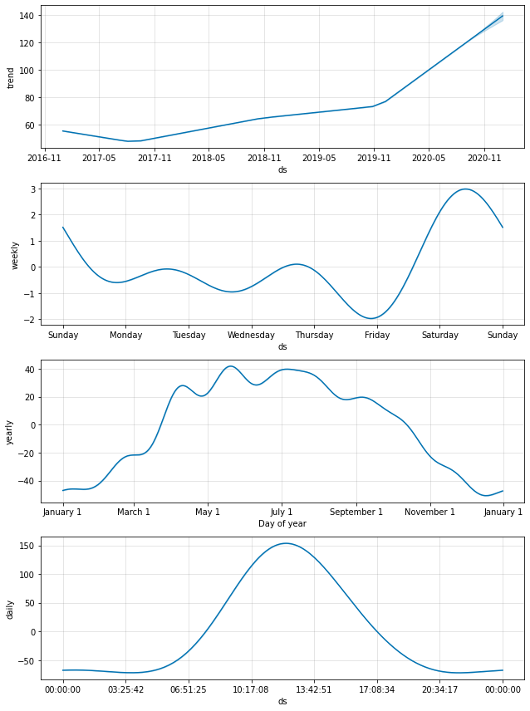
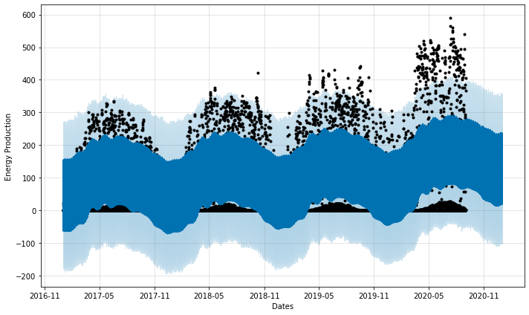
Time series analysis - FB Prophet
Results obtained with uncertainty level set at 95% (default 80%)

Slide 23
Time series analysis - FB Prophet
Overall, the multiples seasonalities have been properly captured by the model
However, the forecasted values are not so satisfying and can be improved
Cross-validation on the training set and a reduction of the forecasting period were considered to try improving the model

Slide 24
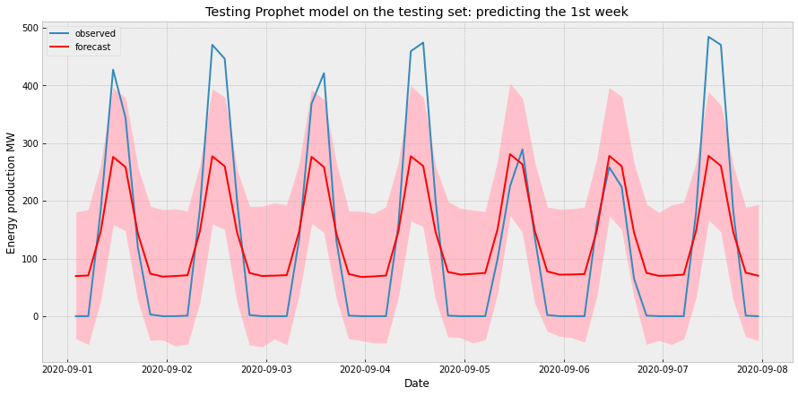
Time series analysis - FB Prophet
Error | Value
RMSE | 60.43
R2 | 0.70
MAE | 47.27

Slide 25
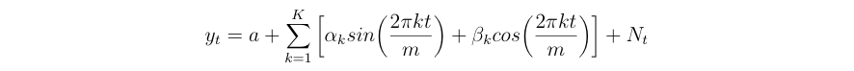
Data modeling - Time series analysis
The 2nd model considered to deal with multiple seasonality : SARIMAX with Fourier series
Reason : Usual SARIMA models are not fit for multiple seasonality
Advantages of the SARIMAX with Fourier series approach :
Flexibility of seasonality length
Data with multiples seasonal periods can be model with Fourier terms of different frequencies
Short-term dynamics are easily handled with a simple ARMA error
with Nt an ARIMA model, m the seasonal period and K a hyperparameter to tune

Slide 26
Time series analysis - SARIMAX with Fourier series
For yearly seasonality, period considered => m = 365.25 (including the leap year)
For daily seasonality, period considered => m = 24
After transformation of training dataset into Fourier series, the best model fitted with auto arima function : SARIMAX (3,1,2)(1,0,1) (AIC criterion = 103743.527)

Slide 27
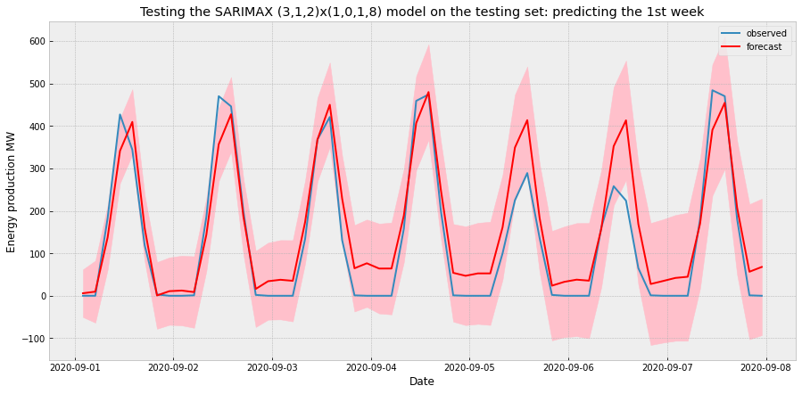
Time series analysis - SARIMAX with Fourier series
Results obtained for a one week forecasting
Error | Value
RMSE | 60
R2 | 0.87
MAE | 47.6

Slide 28
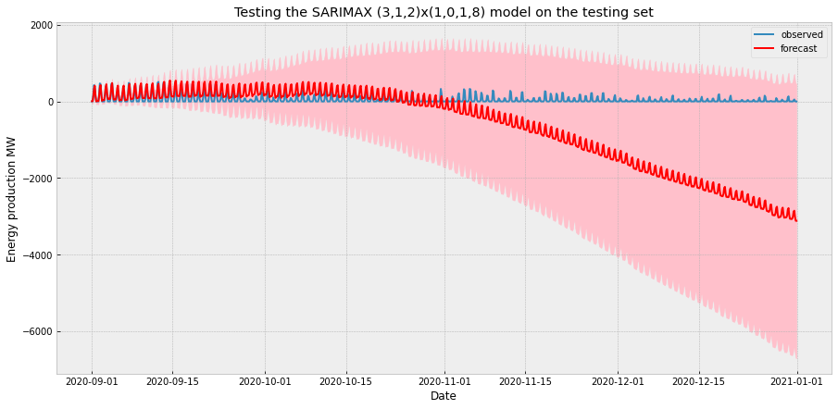
Time series analysis - SARIMAX with Fourier series
Trial for forecasting four months

Slide 29
Time series analysis - SARIMAX with Fourier series
The model seems to be performing relatively well for a one week forecasting but there is still a margin for improvement
The 4 months forecasting trial shows a sharp decline in performance with negative value for energy production from November onwards which is aberrant
Thus, the SARIMAX model is not adapted for long term trends

Slide 30
Data modeling - Machine learning techniques
To furtherly push the modeling step, various machine learning models were considered:
Lasso regression
Elastic Net regression
Random Forest regression
Extreme Gradient Boosting (XGBoost)

Slide 31
Data modeling - Feature extraction for date/time
We used 2 different sets of date time features:
Full hot encoded variables for year (year_2017, …, year_2020), month (month_1, …, month_12) and hour (hour1, …, hour24). This is used only on Lasso regression
Reduced feature space: keeping year as numerical values, reduce months into 4 seasons and reduce hours into 4 time_of_the_day (morning, afternoon, evening, night)

Slide 32
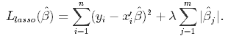
Data modeling - Lasso regression
Lasso, or Least Absolute Shrinkage and Selection Operator, adds a penalty for non-zero coefficients. Lasso penalizes the sum of the absolute values of the coefficients (L1 penalty). As a result, for high values of λ, many coefficients are exactly zeroed under lasso, which allows for automated feature selection.
Lasso tends to do well if there are a small number of significant parameters and the others are close to zero.

Slide 33
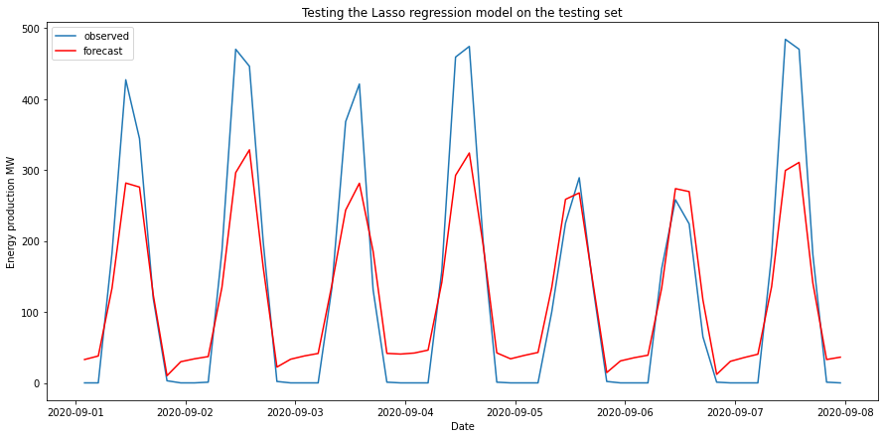
Lasso regression using full hot-encoded variables
Results obtained for a one week forecasting
Error | Value
RMSE | 55.4
R2 | 0.73
MAE | 44.6

Slide 34
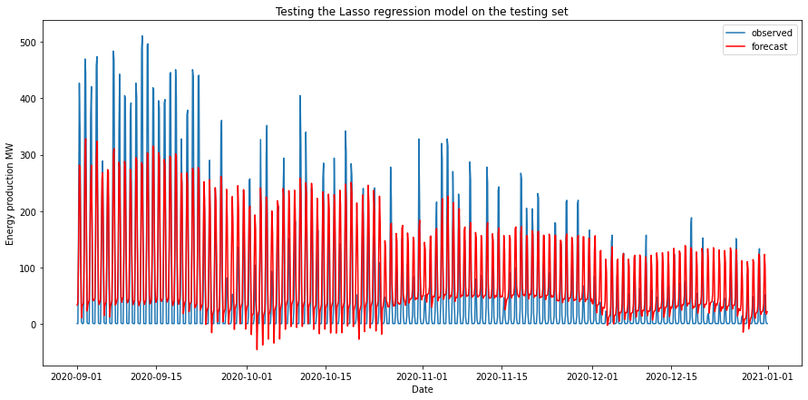
Lasso regression using full hot-encoded variables
Trial for forecasting four months

Slide 35
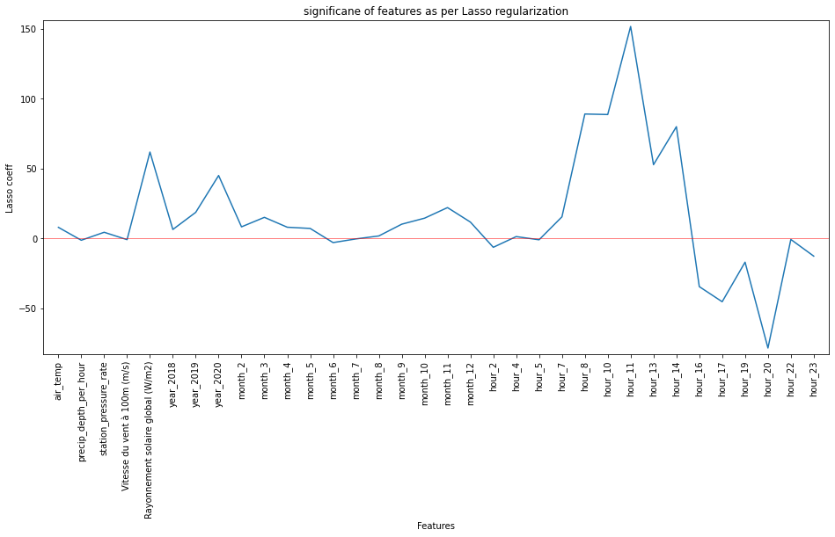
Data modeling - Lasso regression
Hot encoded variables have been used like hour_1, hour_2,..., month_2, month_3,.. etc.
Loss of information as the model assumes that the 23rd hour is far away from the 0th hour (and same for months) which is not the case because of the periodicity of the time series.
To avoid the loss of information and to lower the number of predictor variables we considered feature engineering on the covariates space.

Slide 36
Lasso regression in reduced feature space
Introduction of a season feature capturing month/hour specificity (winter/summer…, night/morning…) for space reduction
The results obtained are not really improved in this framework
Error | Value
RMSE | 60.3
R2 | 0.68
MAE | 44.2

Slide 37
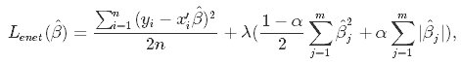
Data modeling - Elastic Net regression
Elastic Net first emerged as a result of critique on lasso, whose variable selection can be too dependent on data and thus unstable. The solution is to combine the penalties of ridge regression and lasso to get the best of both worlds. Elastic Net aims at minimizing the following loss function:
where α is the mixing parameter between ridge (α = 0) and lasso (α = 1).

Slide 38
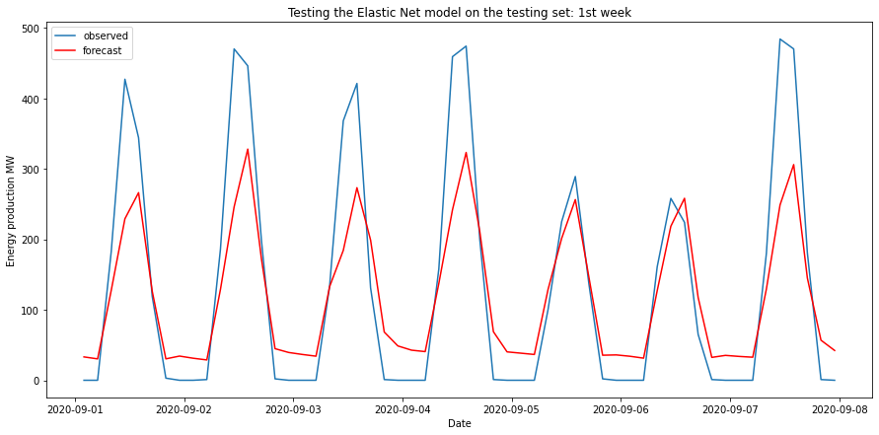
Data modeling - Elastic Net regression
Results obtained for a one week forecasting
Error | Value
RMSE | 83.18
R2 | 0.74
MAE | 60.6

Slide 39
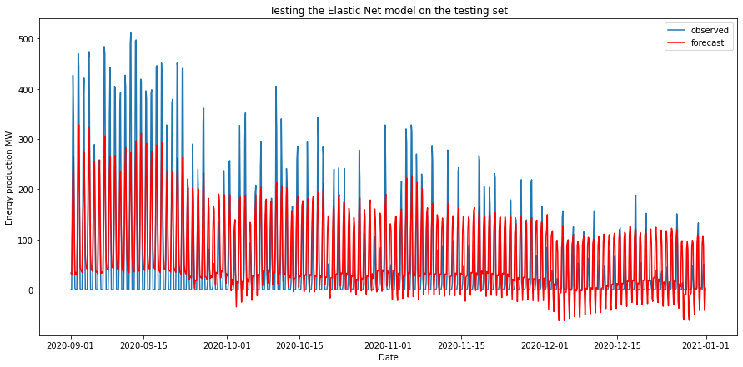
Data modeling - Elastic Net regression
Trial for forecasting four months

Slide 40
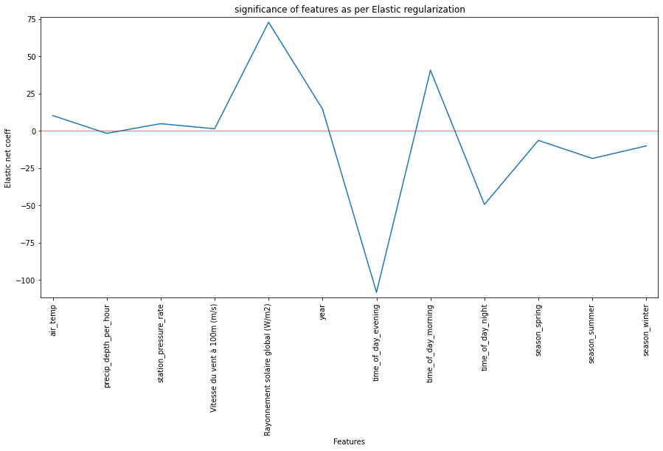
Data modeling - Elastic Net regression
The results are not really improving compared to a Lasso regression

Slide 41
Data modeling - Random Forest regression
Usually the Random forest doesn't perform very well on a time series problem and most often than not it will overfit the data and predict poorly on the test set. But the performance of random forest on a time series problem can be improved by some feature engineering.
We fit random forest on the reduced feature space and used RandomizedSearchCV for best parameters

Slide 42
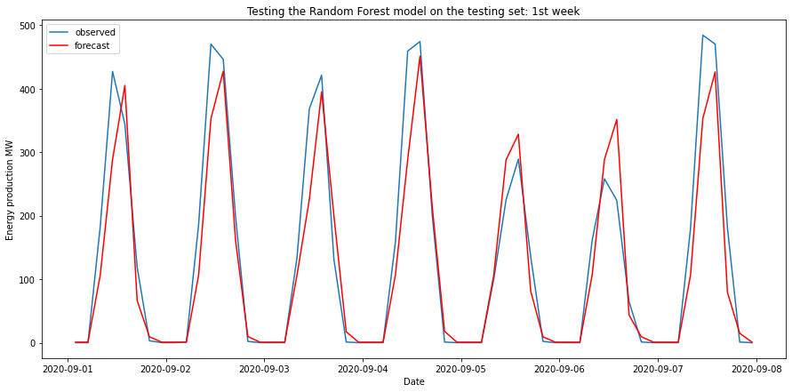
Data modeling - Random Forest regression
Results obtained for a one week forecasting
Error | Value
RMSE | 56.3
R2 | 0.88
MAE | 34.7

Slide 43
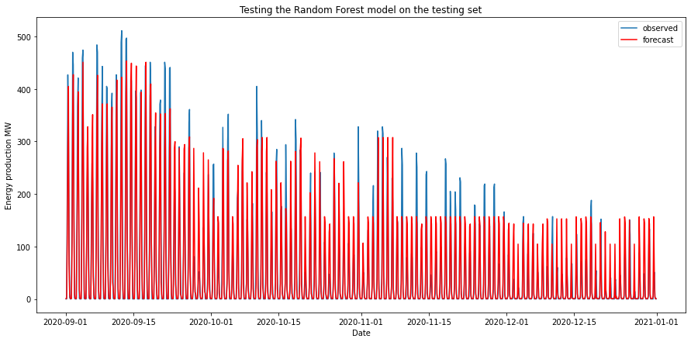
Data modeling - Random Forest regression
Trial for forecasting four months
The results have improved quite a lot compared to linear regressions
But we must be aware of the limitation of extrapolation of Random Forest

Slide 44
Data modeling - XGBoost
XGBoost (Extreme Gradient Boosting) belongs to a family of boosting algorithms and uses the gradient boosting (GBM) framework at its core. It is an optimized distributed gradient boosting library.
XGBoost is well known to provide better solutions than other machine learning algorithms.

Slide 45
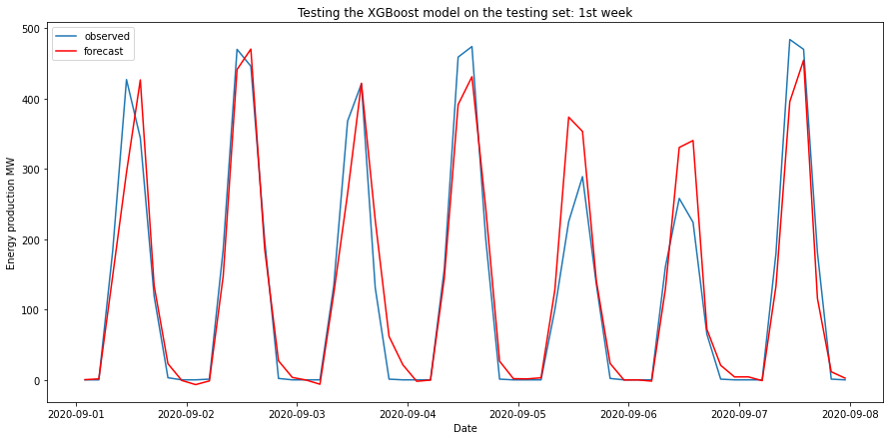
Data modeling - XGBoost
Results obtained for a one week forecasting
Error | Value
RMSE | 47.3
R2 | 0.92
MAE | 30.1

Slide 46
Data modeling - Deep learning techniques
Deep learning techniques were also considered to model the problem :
Artificial Neural Network (ANN)
Long Short Term Memory (LSTM)

Slide 47
Data modeling - Artificial Neural Network
Model architecture
One input layer, one hidden with 96 neurons and one output
Activation function : Rectified Linear function (ReLU)
Optimizer : ADAM
Loss function : Mean square error (MSE)
Simple model without covariate

Slide 48
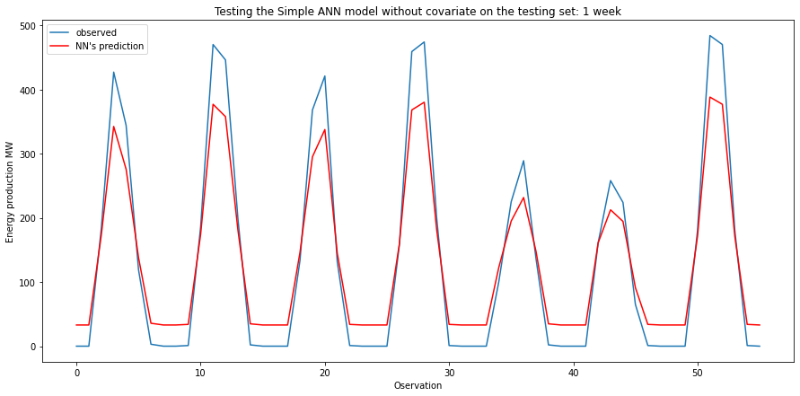
Data modeling - Artificial Neural Network
Results obtained for one week forecasting
Error | Value
RMSE | 45.6
R2 | 0.92
MAE | 38.1

Slide 49
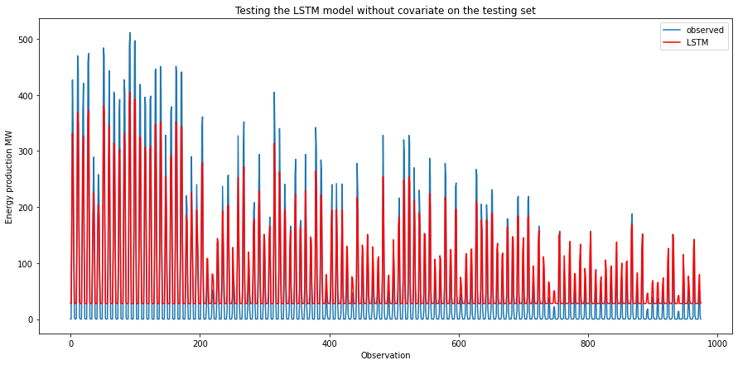
Data modeling - Artificial Neural Network
Comparison with testing set
Error | Value
RMSE | 35.4
R2 | 0.89
MAE | 32.6

Slide 50
Data modeling - Long Short Term Memory
Model architecture
One input layer, one hidden layer with 100 LSTM neurons
The output layer performs single-value prediction
Activation function : ReLU
Training time : 100 cycles
Each time 96 sample used for training
Without covariate

Slide 51
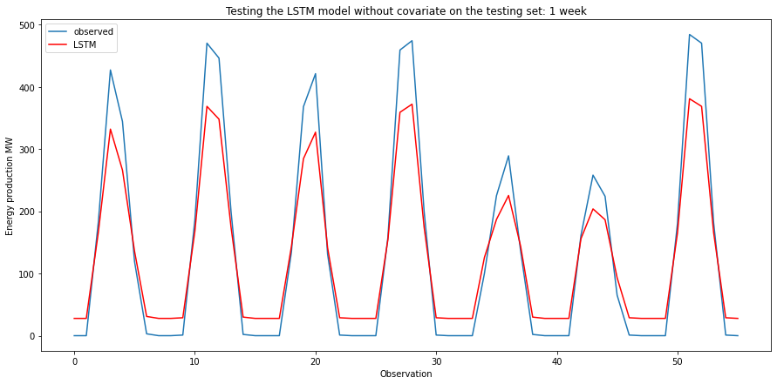
Long Short Term Memory without covariates
Results obtained for a one week forecasting
Error | Value
RMSE | 47.8
R2 | 0.92
MAE | 38.4

Slide 52
Long Short Term Memory without covariates
Comparison with testing set
Error | Value
RMSE | 34.5
R2 | 0.89
MAE | 30.5

Slide 53
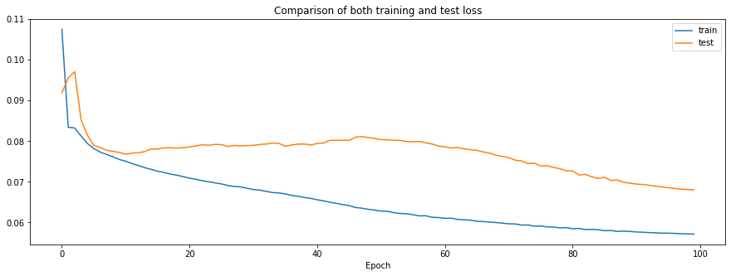
Data modeling - Long Short Term Memory
To further improve the quality of the model, covariates have been added to the input data using the same LSTM architecture
Weather conditions
Solar radiation

Slide 54
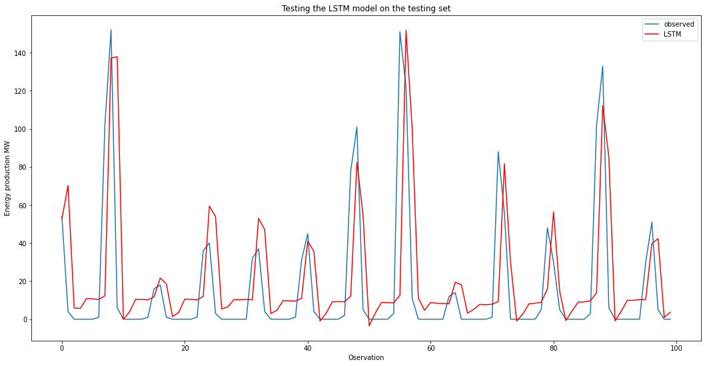
Long Short Term Memory with covariates
Results obtained for a one week forecasting
Error | Value
RMSE | 66.2
R2 | 0.6
MAE | 40.2

Slide 55
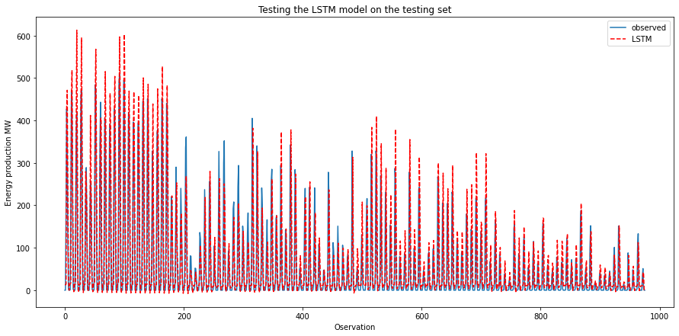
Long Short Term Memory with covariates
Comparison with testing set

Slide 56
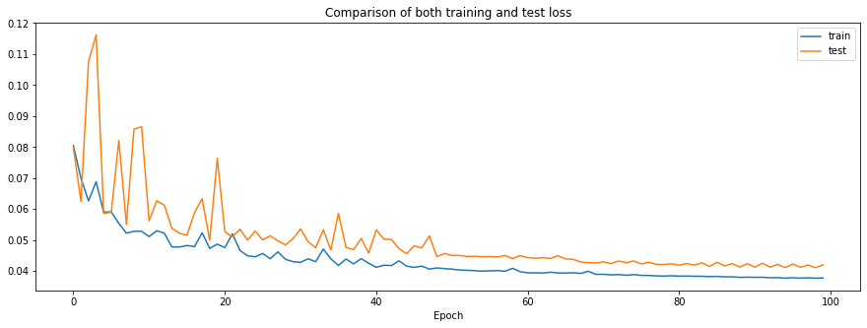
Data modeling - Long Short Term Memory
Like in the lasso regression, a season feature have been introduced to capture the month/hour specificity (winter/summer…, night/morning…) for feature space reduction

Slide 57
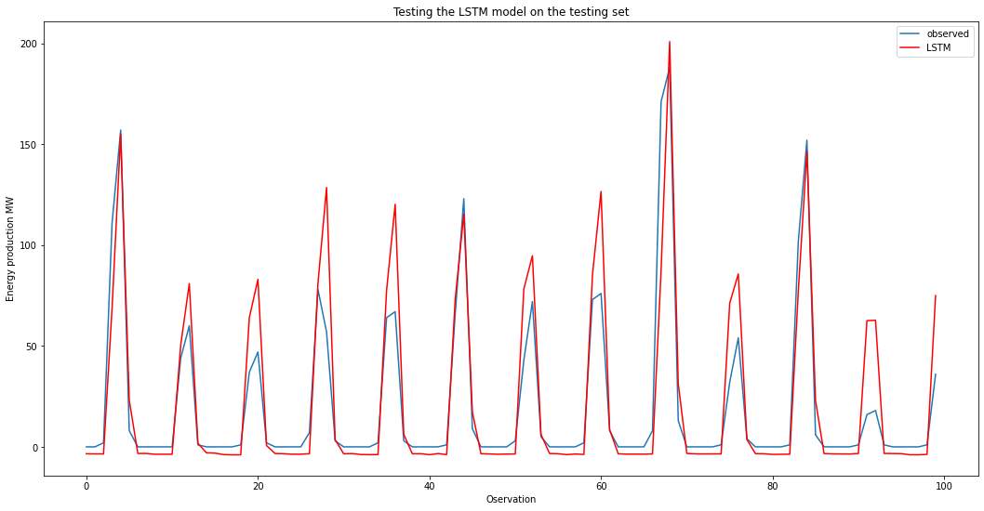
Long Short Term Memory in reduced feature space
Results obtained for a one week forecasting
Error | Value
RMSE | 46.2
R2 | 0.8
MAE | 24.8

Slide 58
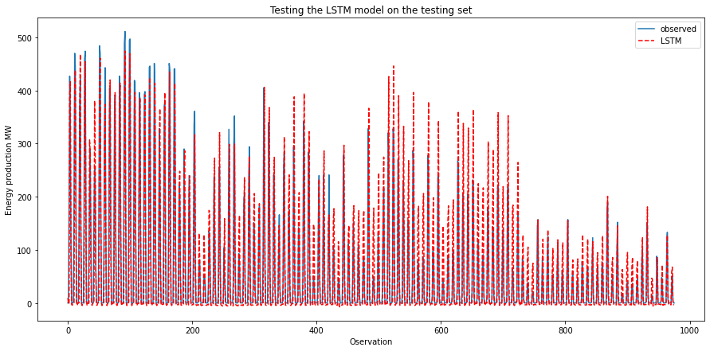
Long Short Term Memory in reduced feature space
Comparison with testing set

Slide 59
Summary table
Models | RMSE | R2 | MAE
FBProphet | 60.4 | 0.70 | 47.3
SARIMAX + Fourier | 60.0 | 0.87 | 47.6
Lasso regression | 55.4 | 0.73 | 44.6
Lasso reg. on reduced feature space | 60.3 | 0.68 | 44.2
Elastic Net regression | 83.2 | 0.74 | 60.6
Random Forest regression | 56.3 | 0.88 | 34.7
XGBoost | 47.3 | 0.92 | 30.8
ANN | 45.6 | 0.92 | 38.1
LSTM without covariates | 47.8 | 0.92 | 38.4
LSTM with covariates | 46.2 | 0.8 | 24.8

Slide 60
Project framework
Project definition
Data mining and processing
Data exploration
Data modeling
Evaluation and prediction
1
2
3
4
5

Slide 61
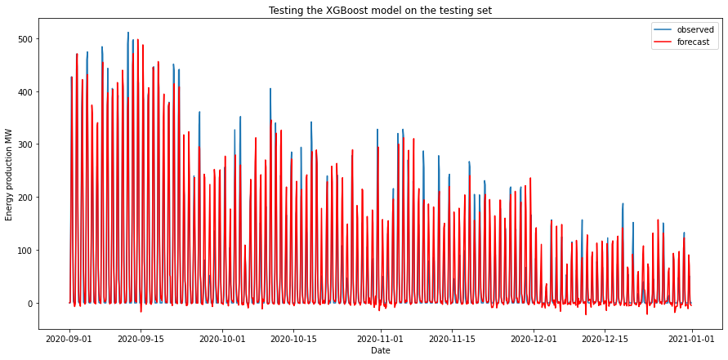
Forecasting results using the best model
Best model chosen : LSTM with covariates in reduced feature space
Error | Value
RMSE | 38.96
R2 | 0.87
MAE | 22.3

Slide 62

Next steps
Evaluate forecast adding lagged values as X variables
Designing API for displaying results
Dynamical update of data for continuous forecasting

